Slide 1
Research Presentation.
Comparative Healthcare Systems.

Slide 2
Introduction.
Healthcare sector is the most important sector in both developing and developed nations.
A population with good health is often considered productive.
Modern healthcare systems have been integrated with technological innovation to improve efficiency.
The healthcare delivery system in the United States has often been overlooked compared to other nations of the world (Mossialos et al., 2015).
The US Healthcare system has been featured with many recommendable practices which facilitate good healthcare services.
The US Healthcare system has often been challenged by multiple barriers which undermine the quality of care (Ridic, Gleason, & Ridic, 2015).
This study provides a comparison the United States health care system with that of Germany and Canada.

Slide 3
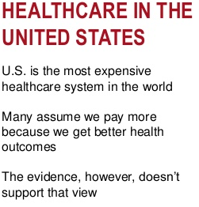
The United States Healthcare system.
Overview of the United States Healthcare system.
The US provides healthcare services through a patchwork of public as well as private insurance plans.
The US has been cost-effectively providing healthcare services.
The US spends more on the provision of healthcare services per a person than it is the case with any other developed country (Ridic et al., 2015).
The US healthcare system has never been straightforward due to the lack of a unified healthcare system.
Notes:
The healthcare system of the united states has often been overlooked for many unique features. The US provides healthcare services through a patchwork of public as well as private insurance plans as federal, state and local government, institutions and individual providers who are not connected (Ridic et al., 2015). The US has been able to often healthcare services in a cost-effective manner through giving increases health care access at an affordable cost. The US spends over double on healthcare per person compared to other developed nations. The US lacks a unified healthcare system which often makes it very sophisticated in understanding how health care services are financed a delivered.

Slide 4
Continuation on the United States Healthcare system.
  Best Healthcare Practice in the United States.
  Affordable Care Act (ACA).
  Medicare and Medicaid programs.
  Qualified healthcare professionals.
  Integration of technology.
Notes:
ACA has been focused on making affordable health insurance available to more people. It has diversified the Medicaid program to cover all adults with low income. It supports innovative medical care delivery approaches designed to lower the cost of health care.
Medicare is a universal nation’s public health insurance program that covers the aged and the disabled in the country. Medicare is comprised of Part A which offer health insurance coverage for inpatient hospital care and some health services, and Part B offers supplementary plans benefits for outpatient hospital services and physicians service. Medicaid offers coverage for to certain economically disadvantaged groups. It is funded by both state and federal governments. Coverage under Medicaid varies from state to state. It finances long-term nursing home stay. The structure of the United States healthcare delivery system comprises of nurses, physicians, volunteers, and patient care technicians. The government has also complement health care staffing by importing knowledgeable employees from other countries. he US offers technology-based healthcare services, and this has brought about growing efficiency. The US is endowed with technologies such as MRI among others.

Slide 5
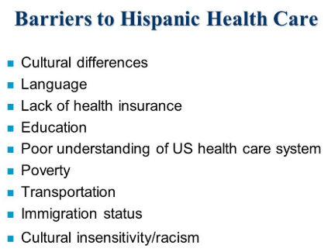
Continuation on the United States Healthcare system.
Barriers to the US healthcare system.
  Lack of national healthcare program.
  The increased cost of care.
  The language barrier and lack of availability of services.
  Lack of culturally competent care.
Notes:
The US healthcare system exists as an element in the private sector. It is dominated by business and insurance companies which are only profit oriented other than providing quality care.
The cost of health care services is increasingly higher, and this makes it challenging for clinics to offer the desired care.
America is comprised of many ethnic groups, and this makes it harder to apply a common language in clinical centers. Some health care services are not available due to lack of the required technology.
Lack of culturally competent care makes care provider unable to provide a proper diagnosis for patients from different ethnic backgrounds.

Slide 6
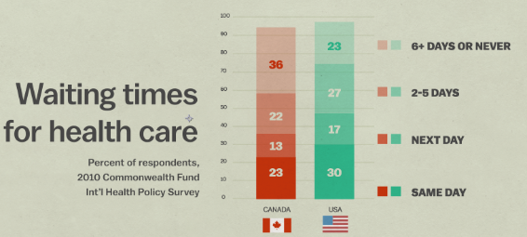
The Canadian healthcare system.
Overview of he Canadian healthcare system.
Canadian health insurance coverage is universal.
General taxes are the main sources of finance to the national health insurance program.
Canada’s healthcare system is featured with a national health insurance program.
Patients do not take part in the compensation process.
Best practices.
Universal coverage.
Regionalization of high-tech services.
Health equity (Lovett-Scott & Prather, 2014).
Maternal and infant health.
Notes:
Canada healthcare system is featured with a national health insurance program which makes an effort to meet the cost of care for the Canadians. Its health insurance coverage is universal. The Canadian healthcare system is financed through general taxes. Patients do not take part in the compensation process. However, it is defined as the role of the government and the health care providers. No money exchange between patient and care provider.
Canadian best practices entail the aspect of universal coverage where every individual is entitled to enjoy the healthcare services without meeting any cost. In regards to the regionalization of high-tech services, Canadian government issues allocation decisions in the effort to control the extent of capital investment in hospitals. This ensures uniformity in service availability (Lovett-Scott & Prather, 2014). Maternal and infant health has been highly emphasized to ensure good physical, mental, emotional, and socioeconomic health of women and their families.

Slide 7
Continuation on the Canadian healthcare system.
Barriers to healthcare services in Canada.
Problems with eligibility and entitlement
Limited access to physicians
Patient unfamiliarity with new systems (Lovett-Scott & Prather, 2014).
Unwarranted finances
Notes:
Canadian health care system is featured with reduced eligibility and entitlement, and this makes the patient fear sharing their information concerning their status. Limited access to physicians is a growing challenge because there are few doctors with the appropriate language and hence it gets harder to accommodate patients of a different culture (Lovett-Scott & Prather, 2014). Patient seems to be less conversant with the Canadian health care system. This provides them with limited understanding which often challenges the need to advocate for their family’s care. The high cost of care can facilitate delays in tests and treatment and medication for those without health insurance.

Slide 8
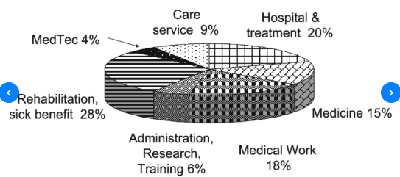
The healthcare system of Germany.
Overview of the healthcare system of Germany.
German’s health care system is determined to ensure “mutual aid in society.”
It is based on the concept of social insurance.
In Germany, it is obligatory to be insured when living, studying or working Germany (Mossialos et al., 2015).
Germany has a dual system with compulsory insurance as well as private insurance.
Best practices.
It offers comprehensive coverage of health care.
It has nationwide coverage of interventional treatment for acute myocardial infarcts
Medical innovation rapidly finds its way into patient care.
Promotion of technology and competence.
Notes:
Germany offers an all-around coverage of health care cost to almost every citizen. It supports infarct nets which allow citizens to be treated interventional for acute myocardial infarcts. The government believes in the power of reimbursement for new diagnostics as well as treatment thus it supports continuous medical innovations (Mossialos et al., 2015). German promotes competence in service provision by hiring foreign doctors to complement the knowledge of homemade doctors.

Slide 9
Continuation on the healthcare system of Germany
Barriers to Germany’s healthcare system.
  The increased cost of healthcare technology.
  Negative individual attitudes towards medical treatment (Lovett-Scott & Prather, 2014).
  Complex connections of local transportation.
  Religious discrimination.
Notes:
It has been costly to support all capital-intensive clinics in Germany fully. They require high minded technical devices and hiring of skilled personnel to offer services. Citizens have a negative attitude towards accessing health care services accounting from cultural perception (Lovett-Scott & Prather, 2014). The lacks avid interconnection amid health care organizations. Healthcare services have been offered on a religious basis in some setting, and this has brought about segregation of Muslim women in accessing services.

Slide 10
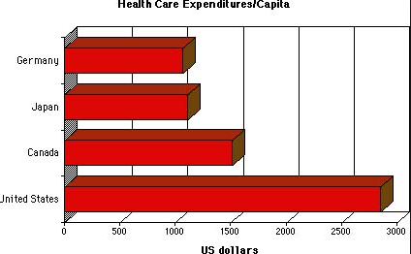
Comparison of health care systems in the United States, Germany and Canada .
The three healthcare system are highly comparable.
They are geared towards ensuring good health for the people.
The three governments have made an effort to subsidize the cost of health care services.
Citizens in each of the nations are required to have healthcare insurance.

Slide 11
Comparison of health care systems in the United States, Germany and Canada Continued……
The US is endowed with many technical machines than her counterparts.
The US spends more on health care per person compared to other countries (Mossialos et al., 2015).
There is much longer wait for services in Canada compared to the United States and Germany.
The three healthcare systems emphasize success and satisfaction for community wellness.
Patients are the most important element in all healthcare sectors.
Medial technology is fully emphasized in the three nations

Slide 12
Conclusion.
Healthcare is the backbone of every successful nation.
U.S. healthcare system remains to be superior and unique compared to those of her counterparts.
Every nation must put more efforts into the aspect of medical innovation while supporting the best practices (Lovett-Scott & Prather, 2014).
Healthcare system needs to be complemented with high minded patient protection practices.
Every country must get to address barriers in healthcare for growing efficiency and universality.

Slide 13
References.
Lovett-Scott, M., & Prather, F. (2014). Global health systems: Comparing strategies for delivering health services. Burlington, Mass: Jones & Bartlett Learning.
Mossialos, E., Wenzl, M., Osborn, R., & Sarnak, D. (2016). 2015 international profiles of health care systems. Canadian Agency for Drugs and Technologies in Health.
Ridic, G., Gleason, S., & Ridic, O. (2015). Comparisons of health care systems in the United States, Germany and Canada. Material socio-medical, 24(2), 112.

